Slide 1
Implementation of Interdisciplinary E-STEM Model to Prepare High School Students in the United Arab Emirates for the Labor Market
Dr. Marwa Eltanahy
Faculty of Education
Higher Collages of Technology

Slide 2
RESEARCH OVERVIEW
STEM Applications
Workplace Shortage
01
03
STEM Professions.
Knowledge –based Economy
“E-STEM”.
02
04
Notes:
Research explained that STEM education is important to everyone because its activities benefit all students with different career desires as a result of the consistent implementation of the logical process of thinking through problem solving activities.
Although the ability to generate successful STEM students who can place themselves in the labour market affects the strength of the economy. The number of UAE students who study STEM subjects as a major is limited. This causes a shortage in the STEM workforce of UAE and reflects that STEM professions do not stimulate all students. Accordingly education should provide STEM students with new learning opportunities to pursue the required careers that fit their ambition. Interdisciplinary E-STEM learning was offered to address this problem.
In the light of knowledge-based economy, entrepreneurship takes new significance because knowledge generated in one field can be commercialized in another field through implementing entrepreneurial practices This makes STEM classes one of the best contexts to incorporate entrepreneurial learning and integrate its activities.
Research concerning STEM reform recommended updating the curricula disciplines of STEM education ‘to align with the on-going renewal of school curriculum with the focus on nurturing students’ creativity, collaboration, problem solving skills and innovativeness through student-centered pedagogies, and pave the way for nurturing students’ entrepreneurial spirit in senior secondary subjects
(Van Horne, Huang, & Al Awad, 2012).
(Aslam, Abu-Ageel, Alfatlawi, Varney, Thompson, & Aslam, 2014).
(Moonesar, Mourtada, Shaer, Al-Eisawi, & Elomari, 2015).

Slide 3
RESEARCH GAP
Science inquiry
Yet, little is explored regarding the teaching pedagogy of E-STEM learning model and its outcomes.
Entrepreneurial act
Technological literacy
Situated STEM learning
Mathematical thinking
Situated E-STEM learning
Engineering design
Notes:
Although students’ STEM designs are widely desired, relatively little attention has been given to making use of these designs, by incorporating a basic understanding of the market to create new values for the community. E-STEM model was developed in 2020 to incorporate entrepreneurial practices into STEM education and to close the gap between students’ STEM outcomes and the market. Yet, little is explored regarding the teaching pedagogy of E-STEM model and its outcomes.
That is why the Abu Dhabi Education Council (ADEC) stressed the importance of engaging teachers in the process of educational transformation that mainly focus on STEM practices and result in a sustainable culture of education to generate more entrepreneurs and innovators in different fields (UAEinteract, 2015) through closing the skill gap between students’ learning outcomes and market needs.

Slide 4
STUDY PURPOSE & QUESTIONS
Explore educators’ perceptions regarding the E-STEM learning model that was developed by Eltanahy et al. (2020b).
Explore educators’ views regarding students’ outcomes of the proposed E-STEM model
1. What are educators’ perceptions regarding E-STEM learning model?
2. What are students’ E-STEM outcomes that are valued by teachers?
Notes:
- E-STEM learning model was developed by Dr. Eltanahy and first published in the 6th international conference on Education (ICEDU) in 2020 to incorporate entrepreneurial practices into STEM education and to close the gap between students’ STEM outcomes and the market.The pully system of E-STEM integrates the 5 main disciplines and form a new suitated learning platform.
Yet, little is explored regarding the teaching pedagogy of E-STEM model and its outcomes.
- That is why the Abu Dhabi Education Council (ADEC) stressed the importance of engaging teachers in the process of educational transformation that mainly focus on STEM practices and result in a sustainable culture of education to generate more entrepreneurs and innovators in different fields through closing the skill gap between students’ learning outcomes and market needs.

Slide 5
THEORETICAL FRAMEWORK
Social Constructivist Theory
Entrepreneurial intention Model
(Ajzen, 1991)
Vygotsky, 1987
E-STEM Learning Model
Experiential learning Theory
Situated Cognition Theory
(Kolb, 1994)
(Lave, 1988)
Interdisciplinary Approach
Trilogy of Success
(Campbell et al. 2004)
(Jacob, 1991 )
Notes:
E-STEM Model is supported by a shield of strong theoretical underpinning that includes 6 educational theories.
- The implementation of E-STEM model relies on the constructivist perspective of learning. Social constructivist theory explains how students actively construct knowledge build on their knowledge in social learning environment. The Zone of Proximal Development (ZPD) is a key element in Vygotsky’s theory as it refers to the capacity of students to learn more knowledge with assistance of others.
- The literature advocated that most of the content in STEM integration is grounded in the situated cognition theory where knowledge is situated and embedded in the learning activities bound to cultural, physical, and social contexts in which knowledge was constructed and learned.
- Triology of success: explains the three interrelated key factors affect the learning outcomes (Engagement, capacity, and continuity).
- Interdisciplinary approach: explained that integrated knowledge from different disciplines provide students with meaningful learning opportunities than teaching the same disciplines separately.
- Experiential learning : learning by doing and experimenting allow students to investigate, reflect and enhance any essential learning competencies.
- Entrepreneurial Intention Model: identifies the most important theoretical concepts responsible for enhancing students’ entrepreneurial behavior; entrepreneurial intention, knowledge and attitude that all can be developed through E-STEM model practices.

Slide 6
LITRETURE REVIEW
2010
2015
2018
2019
2020 a/b
Johannisson
Winkler et. al
Kuratko & Morris
Shaer et al.
Eltanahy et. al
Pedagogy-oriented perspective to enhance competencies
ongoing entrepreneurial practices
Developing life long learning skills
integrated teaching programmes are challenging in practice
E-STEM needs involving business teachers & adopts PjBPS
Notes:
Johannisson, in 2010 explained that educating students to act entrepreneurially requires applying teaching approach adopted a pedagogy-oriented perspective or Education-through entrepreneurship to focus on developing competencies of high school students who are not closely connected to the market. Drawing on this perception, the term ‘Education through E-STEM’ is inspired in part by the appropriate features characterized this teaching approach.
Winkler and his colleagues in 2015, explained that embracing a contextualized approach to ongoing entrepreneurial learning practices in the STEM framework is useful to expand the larger entrepreneurship ecosystem.
As Kuratko & Morris, 2018 explained that this will enhance students’ entrepreneurial mindset through developing a set of lifelong entrepreneurial skills. However, the corporation of entrepreneurial practices in education is a critical challenge for teachers who might subscribe it in the abstract with no real tendency to apply it in practice.
Shaer et al., (2019) explained that developing integrated teaching programs” is one of the main challenges mentioned in Mohamed Bin Rashed School of Government MBRSG report
Eltanahy et al. (2020a) argued that this incorporation might be easier for all practitioners by involving business teachers who are knowledgeable enough to incorporate appropriate entrepreneurial practices in an existing STEM course. Accordingly, Eltanahy et al. (2020b) developed interdisciplinary E-STEM model (Figure 1) that incorporates practices of EE into STEM education, and (2020b) Project-based problem solving (PjBPS) is the proposed pedagogical strategy that allow students to actively achieve STEM goals as well as exploit new opportunities to the market.

Slide 7
Interdisciplinary E-STEM Learning
Entrepreneurial Practices (E): Create value /business plan
Science Inquiry: (S) Investigate to build knowledge
Technological Literacy (T) Utilize technology to facilitate your work
Mathematical Thinking (M) Consider measurements, equations. etc.
Engineering: (E) Design a new useful product
E-STEM Model into Practice
Pedagogical Strategies
Actively seeking STEM goals
Student-Competency
Profile
Knowledge
STEM practices
Education-through Entrepreneurship
Competency-based approach
Project-based Problem Solving
Skills
Experiential Learning
Attitude
Decision to exploit opportunity to the market
Education-through E-STEM
Entrepreneurial practices
Interdisciplinary E-STEM Model
(Eltanahy et al., 2020b)
Notes:
educating students to act entrepreneurially requires applying teaching approach adopted a pedagogy-oriented perspective like education through-entrepreneurship to focus on developing competencies of high school students who are not closely connected to the market (Johannisson, 2010).
Drawing on this perception, the term ‘Education through E-STEM’ is inspired in part by the appropriate features characterized this teaching approach.
Literature concerning progression of learning inspired the expression of “Developmentally oriented instruction” (Shemwell et al., 2015, p. 1165). This developmental learning approach explains students’ deep understanding to certain idea requires regular and consistent practices over an extended period to enhance their reasoning skills and abilities to apply the new knowledge in different situations.

Slide 8
METHODOLOGY
Students’ Demographics
24 Boys
01
Context
Grade 11
42 Students
American Curriculum school in Sharjah
02
18 Girls
Sampling
QUALITATIVE CASE STUDY
Purposeful sampling technique
Teachers’ Demographics
03
Participants
Reference
12 educators (11 STEM teachers + 1 curriculum coordinator
Notes:
A qualitative case study was employed to develop depth understanding of the implementation of interdisciplinary E-STEM model.
- Sampling: Purposeful sampling contains a relatively small number of participants is adequate through homogenous sample selection to obtain saturation that fulfils the purpose of a qualitative research. Criterion-base selection (all are STEM experienced teachers teach the same class). Participates were nominated by the school and recruited voluntarily

Slide 9
METHODOLOGY
Training Sessions | Content | Focus
Session 1 | Rationale of Interdisciplinary E-STEM Model | Advantages of integrating E-STEM disciplines
Session 2 | E-STEM Pedagogical strategies | Project-based problem solving and experiential learning
Session 3 | Competency-based Approach | Student-competency profile
Session 4 | E-STEM Strategic Plan | Six main strategies developed by Author. (2020b)
Session 5 | E-STEM Strategic Plan | Planning for E-STEM lessons
Investigation of E-STEM Model
E-STEM Teacher-Training
- 5 Sessions/2Weeks
- Contextual Factors
- 12 Participants
E-STEM Implementation
E-STEM Teachers | # | Implementation Role | Interview Attendance
Practitioners | 5 | Implemented E-STEM model collaboratively with 42 Gr 11 students | All attended first face-to-face interview for data collection
Observers | 3 | Observed E-STEM sessions to give feedback and recommendations to practitioners and students | All attended second face-to-face interview for data collection
Advisers | 4 | Conducted weekly meetings with practitioners and observers to discuss E-STEM implementation, its challenges and give advises | One only attended the second meeting. Three did not attend any of the interviews conducted
- Different roles of Teachers
- 2 academic terms- 3 sessions/W
E-STEM Teacher Interview
2 Face-to-face,
semi-structured Interview
8 Participants
End of the year
40-60min
Contextual Factors
Notes:
Contextual factors like availability, timetable and interests to apply E-STEM
Contextual factors like availability and time preferences
Interview questions:
- To what extent does E-STEM model guide teachers to facilitate the learning process?
- How do your perceive E-STEM teaching instruction?
- To what extent were you able to observe students’ acquisition of knowledge in each stage of E-STEM strategic plan?
- How were disciplines integrated during the implementation of E-STEM model?
- What is the most valuable E-STEM projects produced by grade 11 students?

Slide 10
Trained Teachers | Nature of E-STEM learning model | E-STEM Practice Time | Students’ development recognition | Students’ valued projects | Education through E-STEM
P1 | More developmental -oriented nature | One semester is not enough for sustained E-STEM experiences | Cannot identify knowledge gained in each stage | Vending machine Smart bus Virtual Reality Lessons | The process was focused more than the knowledge
P2 | Developmental , requires lots of critical analysis | At least one academic year is needed for implementation | Gradual improvement was noticed | Vending machine Smart bus | Learning is embedded in the E-STEM implementation
P3 | Not sure. the process is growing and connected | Long term time and practice are essential | Consistent revision and repetition are needed to develop students’ abilities | Vending machine Smart bus Blind currency | It is not easy to test students’ acquisition of knowledge after each stage in the plan
P4 | Should be embedded in the curriculum | 2 semesters of instruction should be enough | Not easy to recognize a definite increase in knowledge | Vending machine Smart bus | Consistent practices of this model will ensure improvement in skills
P5 | This course has a developmental nature overtime | Long term endeavor of learning | Students’ investigation abilities were clearly developed | Vending machine Smart bus Virtual Reality Lessons | The whole E-STEM method was effective to enhance students’ learning
O1 | requires developmental instruction than definite | Students needed to expand their networking | Family and friends help identify mistakes and put them right | Vending machine Smart bus Blind currency | E-STEM is structured through learning by experience
O2 | All activities are dynamic | Require more time to re-plan for further trials | Students experienced failure many times | Vending machine Smart bus Blind currency | It is not possible to concentrate on the acquisition of knowledge.
O3 | it has a moving , developing nature | Students needed to expand the time to complete the project | Students gained better understanding of entrepreneurial habits | V. machine - Smart bus Virtual Reality Lessons | more learning-by doing to acquire knowledge than memorizing it
RQ1: What are educators’ perceptions regarding E-STEM learning model?
Data Analysis & Discussion
Cross-Cutting Analysis Matrix
Notes:
- Qualitative data collected from both participants regarding E-STEM instruction and its Outcomes were analyzed, compared, interpreted through cross-case analysis to determine patterns across participants’ views, and represented in a narrative form to review the manifestations of agreement and controversy between them. The three fundamental components of the model developed by Miles & Huberman (1994) were utilized to interpret the data:
Data reduction:
Data Display
Conclusion
- display matrix of cross-case analysis linking practitioners’, observers’ and advisors’ views to explore how E-STEM instruction is perceived. Time required for E-STEM implementation, recognition of students’ development of abilities, the most valued E-STEM projects are presented as well as features of Education through E-STEM.

Slide 11
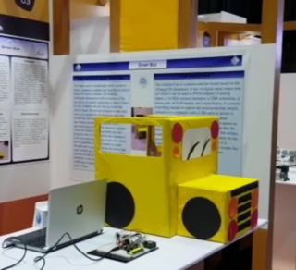
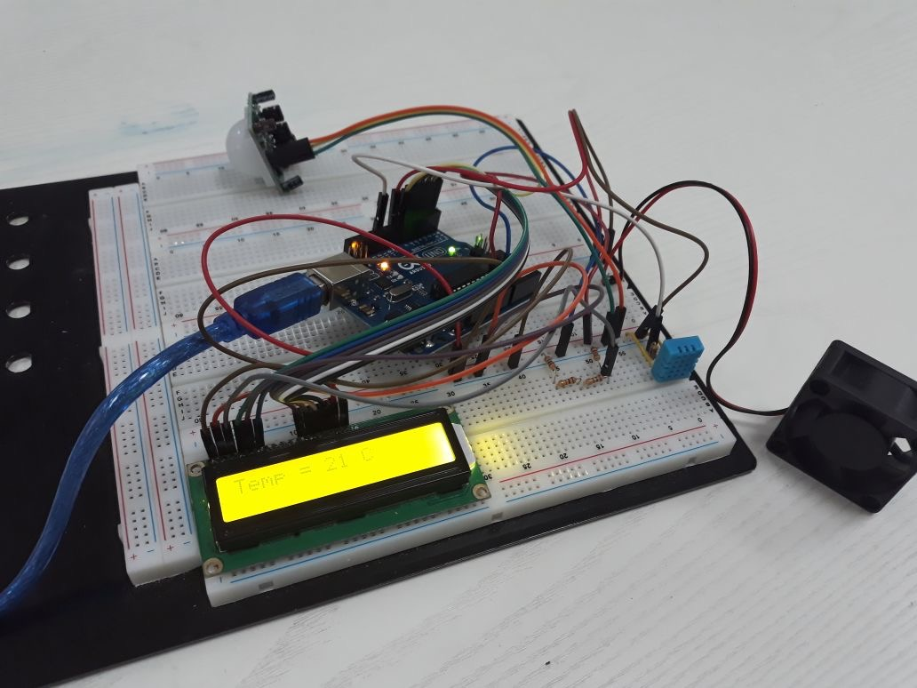
E-STEM VALUABLE OUTCOMES
RQ2. What are students’ E-STEM outcomes that are valued by teachers?
Students’ E-STEM Projects
Virtual Reality Lesson
Vending Machine
Smart Bus
Blind Currency
E-STEM Project 1: used in the school community to sell different essential items, such as uniforms, books, stationery …etc..
E-STEM Project 3: help blind people to identify the amount of money they have or receive from others
E-STEM Project 2: aims to track children in the school bus not to be left behind
E-STEM Project 4: use technology to create a simulated-educational environment
Notes:
Four E-STEM projected were valued by educators
Project 1: Achieved project in the school community
Project 2: Introduced in the think central day and the sticker was sold to some parents to pilot the idea.
Project 3: The students introduced their prototype in a new school programme called Taqaddam, which is a partnership project between the British Council and HSBC bank. This programme helps students reach their potential and develop life skills to serve the community.
Project 4: Students were able to reduce the cost of this product in comparison to the equivalent products found in the market. Moreover, the prototype and the business plan were introduced in the Taqaddam programme, and it was nominated to be one of the top ideas that can be adopted in the educational field.

Slide 12
FINDING & CONCLUSION
E-STEM Learning
RQ1: . How do educators perceive E-STEM Learning Model?
- E-STEM is perceived as a developmental-oriented course that prioritize long-term growth of students’ entrepreneurial competencies. own text.
- Features of Education through E-STEM approach were emphasized during the implementation because it focuses on the process rather than the content.
- The strategic plan of E-STEM model is well-designed because it guides teachers successfully to facilitate E-STEM classes.
Project-based problem solving should have an ill-structured problem to inspired students to produce useful E-STEM projects to benefit others
E-STEM Outcomes
RQ2. What are students’ E-STEM outcomes that are valued by teachers?
Students were being quite innovative and resourceful with the support of the school, families, and friends.
Students designed valuable E-STEM projects to the community
Students practiced many basic entrepreneurial skills and enjoyed their learning experiences
Students have the potential to act as both inventors and entrepreneurs

Slide 13
IMPLICATION
Accommodate E-STEM learning in curriculum
Participate in curriculum mapping
Enhance STEM education reform by restructuring STEM education to accommodate entrepreneurial practices
Curriculum Developer
Researchers
Teachers
Text
Policy Makers
E-STEM Learning Development
New agenda to investigate more about the effectiveness of E-STEM learning model and further development of integrated curriculum

Slide 14
Dr. Marwa Eltanahy
Higher Collages of Technology
Research Journey never ends

