Slide 1
Higher Colleges of Technology
ECE 3503: ASSESSMENT IN EARLY CHILDHOOD
From Theory to Practice
Dr. Marwa Eltanahy

Slide 2
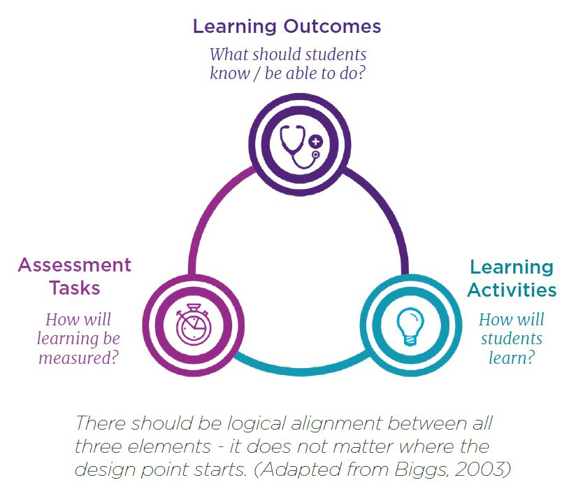
Constructive Alignment Theory
The Relationship between Planning, Teaching and Assessment
Curriculum
Standards/ Objectives / intended learning outcomes
Teaching & Learning
Instruction / activities
Assessment
Types and tools to measure actual learning outcomes
Theory

Slide 3
Constructive Alignment Theory
Learning Outcomes
Assessment Methods
Teaching & Learning Activities
Measurable outcomes are articulated first, from these, the assessment criteria are developed
Once the (aligned) assessment have been designed, resources are chosen, and activities are planned. The curriculum is designed to align the assessment with the outcomes
What the teacher does and what the students do are aimed at achieving the outcomes by meeting the assessment criteria. This takes advantage of the known tendency of students to learn what they think will be assessed.
Theory

Slide 4
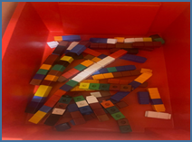
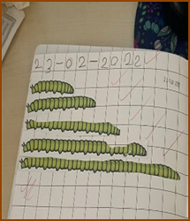
Planning, Teaching & Assessment
Topic: compare and order the length of different objects.
Curriculum planning “Intended Outcome” What are they? | Teaching instruction “well-structured instruction” Success Criteria & WAGOLL | Assessment “aligned to the outcome ” Which Tools?
Students will be able to arrange different objects. Students will be able to measure different objects using cubes. |  | Teacher will use Anecdotal note to assess students’ moral and behavior domain Teacher will use Checklist to assess students’ cognitive outcomes
Practice
Use Success Criteria

Slide 5
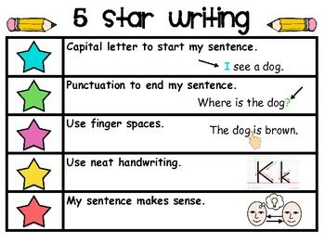
What are Success Criteria?
Success criteria: I can statements that specifically outline what the students need to do in order to achieve the learning goals.
Learning Objectives
“what”
Students will be able to write “I can” sentence.
Success Criteria
“How”
Practice

Slide 6
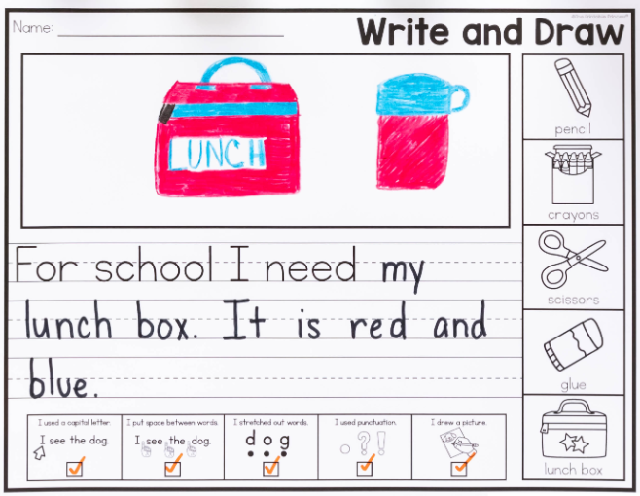
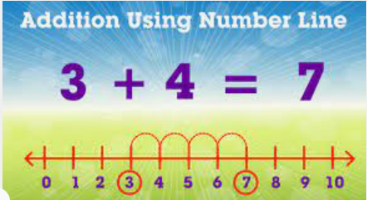
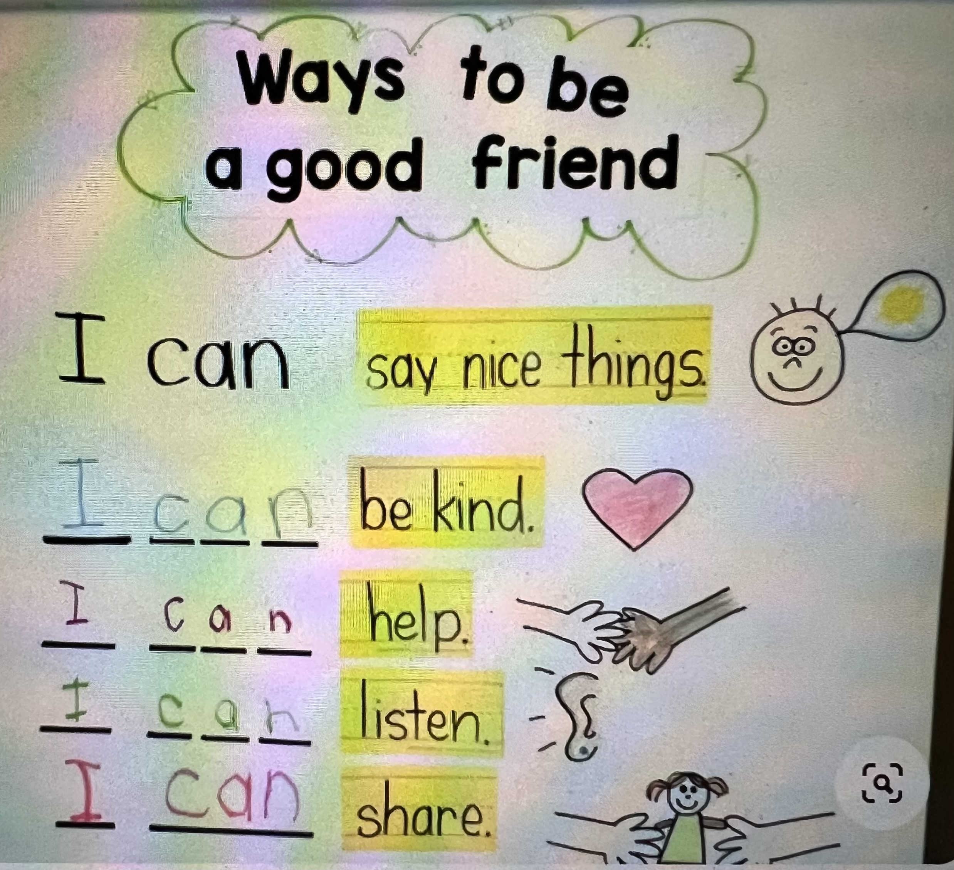
What is WAGOLL?
Teachers
should not be the only reference in the class.
Students should be trained to use Success criteria & WAGOLL to work independently and assess their outcomes
The acronym WAGOLL' means 'What a Good One Looks Like’
These are 'good' and detailed model texts or examples of effective writing, teachers may use to help their students create an exemplary piece of writing.
They are ‘good’ examples of work that teachers can give students to look at to provide inspiration for their own work
It enhances students’ ability for self-assessment &promote their independent learning skills
Practice

Slide 7
What to assess?
Performance
Measures students’ achievement at a single point.
Compare students’ performance to a standard
Progress
Measures students’ development between two points.
Compare students’ performance to their own prior knowledge
Theory

Slide 8
What to assess?
Performance
202210 | Math | Science
Student 1 | 80% | 78%
Student 2 | 60% | 83%
Student 3 | 40% | 75%
Student 4 | 90% | 94%
Progress
202220 | Math- Semester 1 | Math- Semester 2
Student 1 | 80% | 90%
Student 2 | 60% | 61%
Student 3 | 40% | 68%
Student 4 | 90% | 88%
Progress
No Progress
Progress
No Progress
Practice

